Slide 1
Project II - Bus Reservation
Binaya Dahal
MCA 3rd Semester
Course Code: MCA216
Roll No: 334856

Slide 2
Table of content
Introduction
Problem statement
Literature Review
Objectives
User Heirarchy
Context Level Diagram
Data Flow Diagram
Usecase Diagram
Entity Relationship Diagram
Advantages and Drawbacks

Slide 3
Introduction
An online portal for bus ticket reservation
Aims to make bus reservation easy
Allows user to choose seat of their choice

Slide 4
Problem statement
Need to contact travel agency to book a ticket
Not all travel agency have their own online bus reservation system
Hard to book bus at festival season
Lack of proper web portal for bus reservation

Slide 5
Literature review
westnepalbus.com
They provide:
Destination choice
Date and shift choice
Print ticket facility
Contains wide range of travel routes
List of available bus agency
Belongs to an organization
They lack:
Doesn’t show bus availability
Need to call office to see if bus exists
Broken links

Slide 6
Literature Review (Continued)
busnepal.com
They provide:
Destination choice
Date and shift choice
Print ticket facility
Contains wide range of travel routes
Support for payment gateway like esewa and ipay
They lack:
No search result after searching
Need to call to see if bus is available
Popped error page every now and then

Slide 7
Objectives
To allow users to book bus seats of their choice.
To bring different bus agencies into single platform.
To make bus booking easier.

Slide 8
User Heirarchy
The system will consists of 4 types of user:
User: normal user that book tickets
Agency Member: member of travel agency that can add / remove routes, buses under its supervision and tickets cancellation
Agency Admin: access similar to Agency user but has usermanagement facility to manage it employee
Super Admin: master user that can add/remove travel agency, agency admin and places

Slide 9
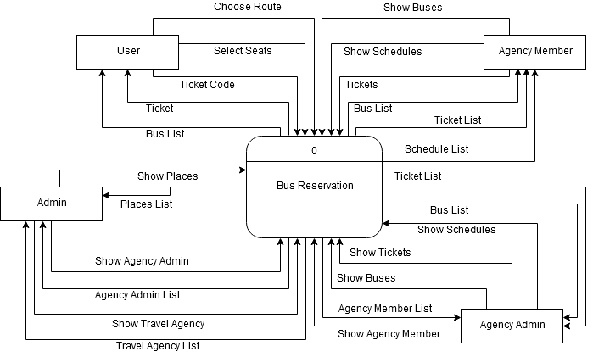
Context Level Diagram

Slide 10
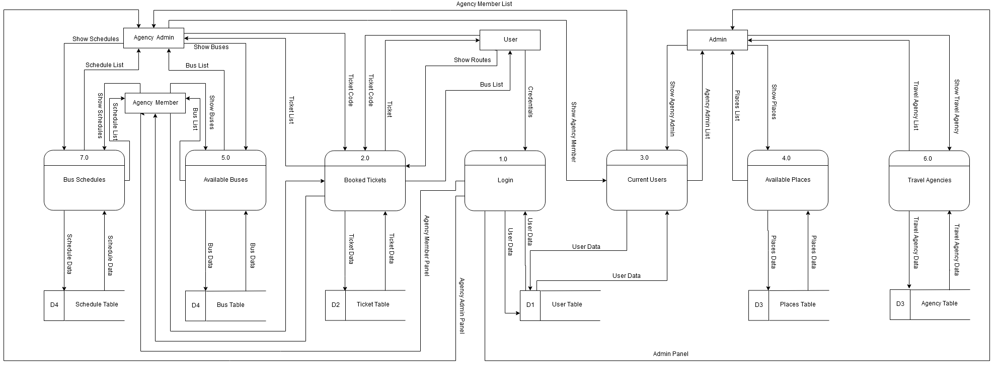
Data Flow Diagram

Slide 11
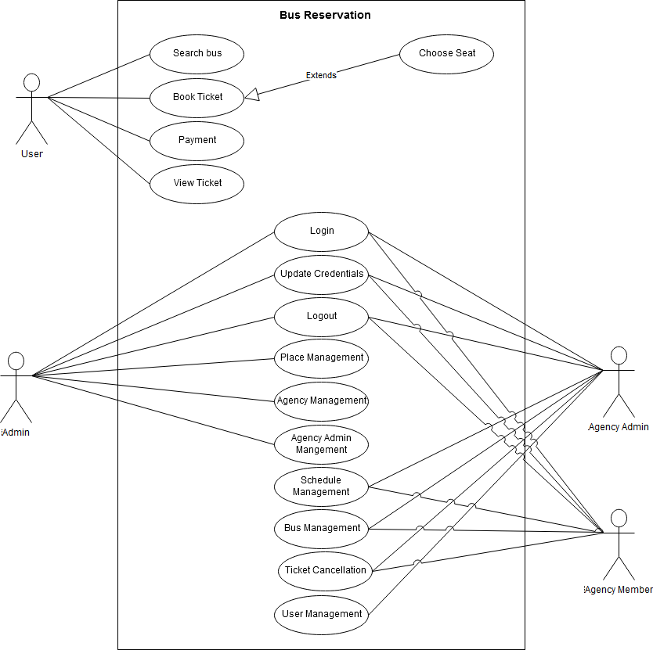
Usecase Diagram

Slide 12
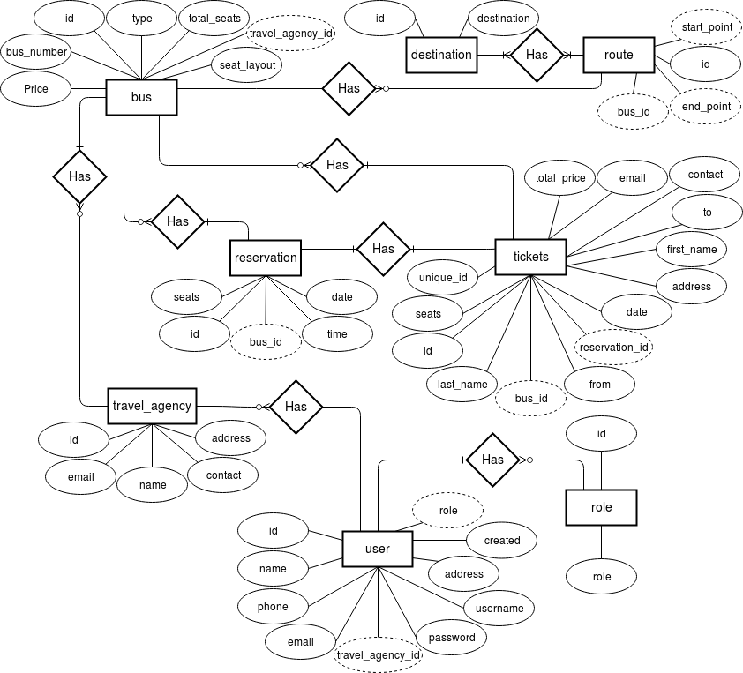
Entity Relationship Diagram

Slide 13
Advantages and Drawbacks
Advantages
Bus searching and booking on single portal
Supports wide range of travel routes per travel agency
Ticket searching and download facility
Seat searching facility
Drawbacks (Future Enhancement)
Lacks support for payment gateway (requires fee for testing this feature)
Lacks mobile device support
Lacks the ability to create seat layout of our choice

Slide 14
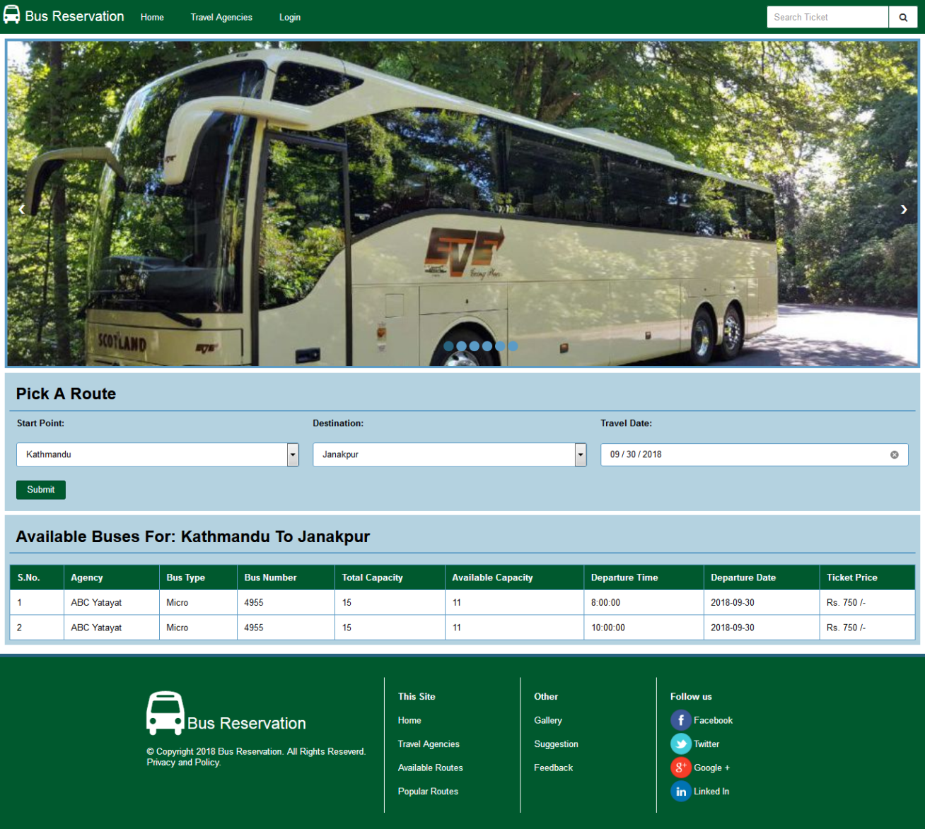
Screenshot – User Home

Slide 15
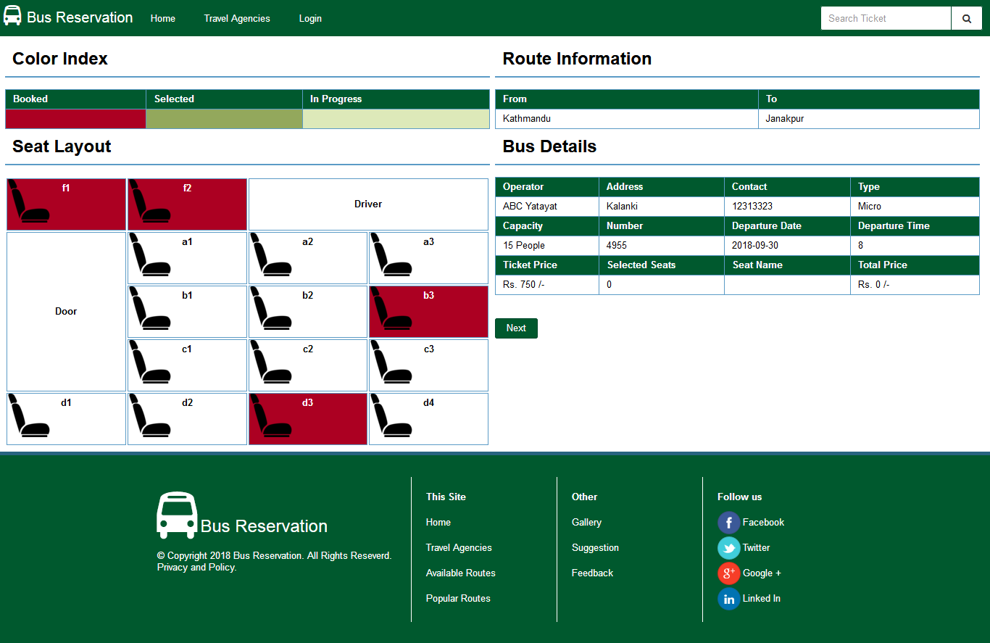
Screenshot – Seat Selection

Slide 16
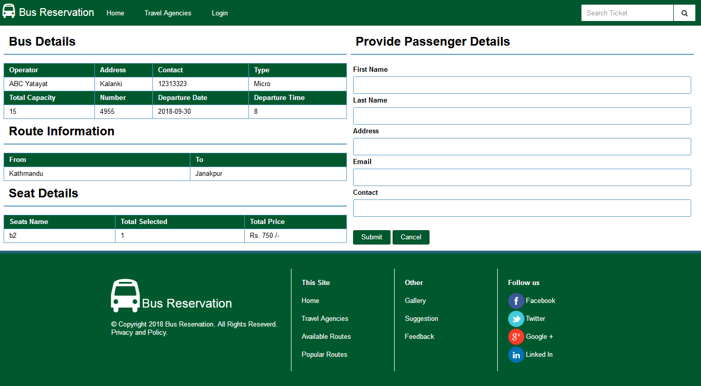
Screenshot - Passenger Infromation

Slide 17
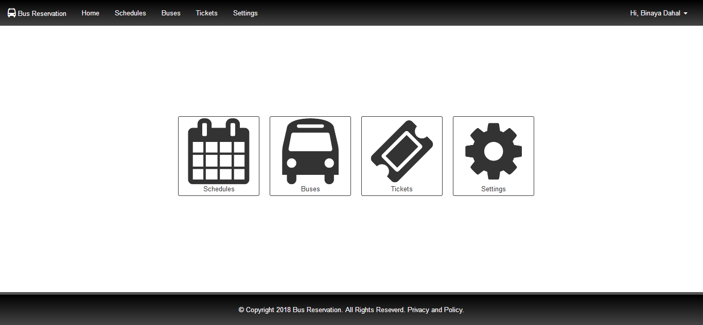
Screenshot – Member Home

Slide 18
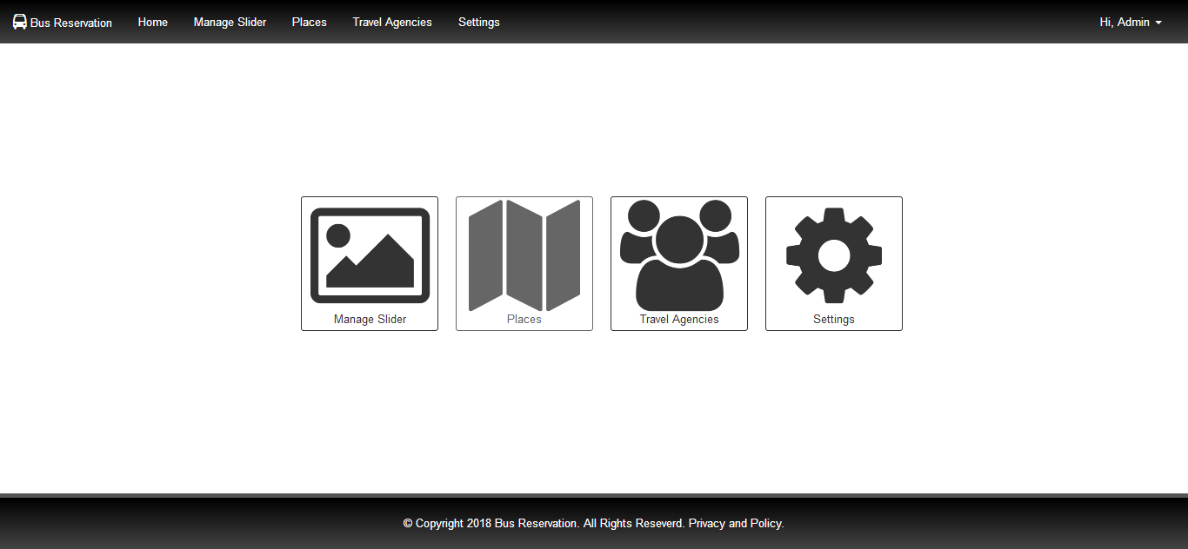
Screenshot – Admin Home

Slide 19
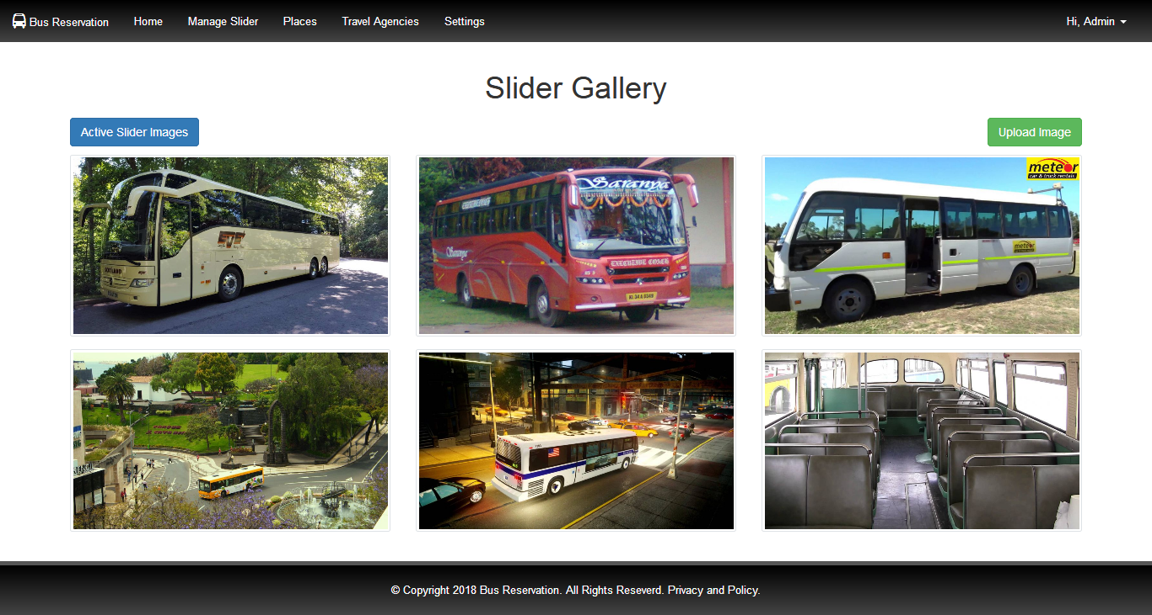
Screenshot – Slider Gallery

Slide 20
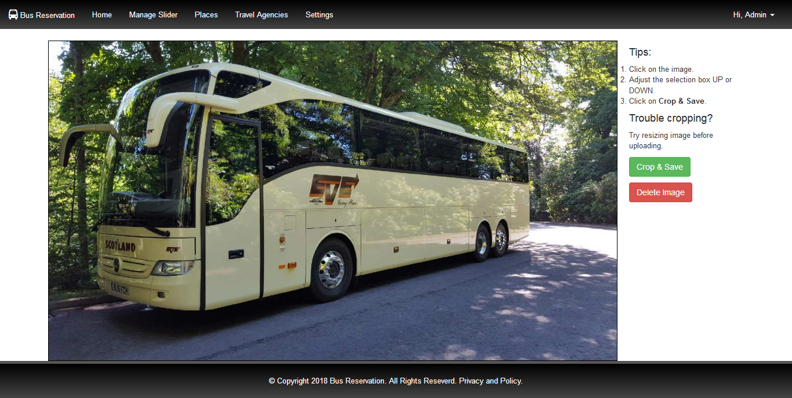
Screenshot – Slider Image Manager

Slide 21
Thank You For Your time!

